Slide 1




THE FUTURE IS HERE.
ARE YOU READY?
OPEN TO 10TH - 12TH GRADERS
THURSDAY, OCTOBER 24
2:00 PM - 6:00 PM
TCC & LIVELY CAMPUSES
EXPERIENCE
WORLDS OF WORK
AT YOUR OWN PACE
HANDS-ON ACTIVITIES
DOOR
PRIZES
SCHOLARSHIP
GIVEAWAYS
REGISTER HERE!
www.NorthFloridaWorldsofWork.com

Slide 2
Senior Year & Post Secondary Planning
Presentation by Teresa Dennis
LCVS Senior Advisor

Slide 3
Graduation: Class of 2025
  Senior Brunch: February 21, 2025, 11:00am
  Graduation Rehearsal: May 15, 2025; 2:30-4:00pm at Chiles High Auditorium
  Graduation: May 16, 2025; 6:00-8:00pm at Chiles
  Graduation Requirements For Students Entering Grade 9 before 2024-2025 School Year:
  Academic Advisement Flyer
  Graduation: Class of 2025
  Florida Literacy Exam – this is a must take exam that is taken senior year (no minimum score required; however, college students must pass this exam for completion of an A.A. or A.S. Degree)

Slide 4
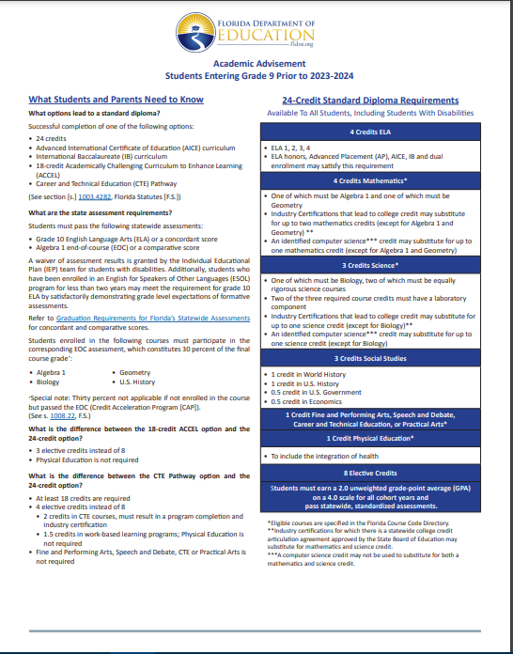
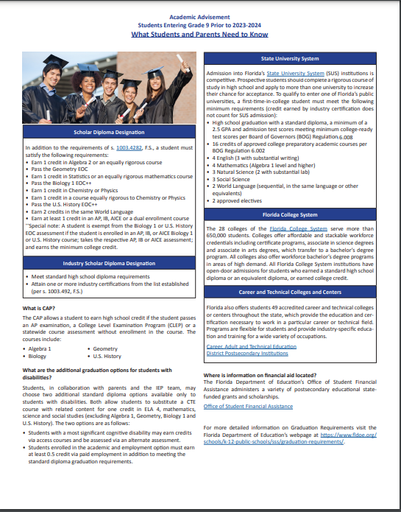
FLDOE Academic Advisement Flyer

Slide 5
Standard Diploma Requirements: 24 credit diploma
4 credits in English
4 credit in Math to include Algebra I and Geometry
3 credits in Science to include Biology
3 credit in Social Science: World History, US History, Economics/US Government
1 credit in Fine/Approved Practical Art
1 credit in HOPE-PE
8 Elective Credits
2.00 unweighted Cumulative GPA
Pass Grade 10 FSA/FAST ELA
Pass Algebra EOC

Slide 6
Standard Diploma Requirements: ACCEL diploma
4 credits in English
4 credit in Math to include Algebra I and Geometry
3 credits in Science to include Biology
3 credit in Social Science: World History, US History, Economics/US Government
1 credit in Fine/Approved Practical Art
3 Elective Credits
2.00 unweighted Cumulative GPA
Pass Grade 10 FSA ELA
Pass Algebra EOC

Slide 7
Options After High School
Workforce
Military: Active, Reserves,ROTC,Academy
Vocational School
State/Community/Junior College
University

Slide 8
Applying to College
Families should be able to answer the following questions for themselves:
  Does your student like school? Have they been successful?
  What institutions best fit the student’s academic and social interests and educational objectives?
  How much is the family able to reasonably afford to help the student meet his or her educational goals? *Use Net Price Calculator to estimate costs for attending college

Slide 9
Consider 2 to 6 Colleges
Freshman Retention Rate: how many students return after their freshmen year?
How big are freshmen classes?
6 yr Graduation rate?
Are freshman required to live in a dorm?
AP credit policies?
2 reaches
3 targets
1 safety
visit campus
Talk with alumni
www.collegeweeklive.com

Slide 10
SAT Reasoning Test
www.sat.org/register
LCVS Code: 102628
SAT @ $55
Test Date: Oct. 5 / Registration by 9/20
Test Date: Nov. 2 / Registration by 10/18
Test Date: Dec. 7 / Registration by 11/22
Test Date Mar. 8 / Registration by 2/21
Fee Waivers available for eligible students
  https://collegereadiness.collegeboard.org/sat/register/fees/fee-waivers - you can request directly from SAT or contact Mrs. Dennis or Mrs. Bradley for assistance.

Slide 11
SAT Practice
Free Practice Questions , Practice Test and tutorials from Khan Academy
https://collegereadiness.collegeboard.org/sat/practice
https://www.khanacademy.org/sat
  *You can connect your free Khan Academy account with your Collegeboard (SAT) Account to access free personalized test prep

Slide 12
ACT
www.actstudent.org
LCVS School Code: 102628
ACT @ $60
ACT with Writing @ $85
Test Date: Oct. 26 / Registration by 9/20
Test Date: Dec. 14 / Registration by 11/8
Test Date: Feb. 8 / Registration by 1/3
Fee Waiver eligibility https://www.act.org/content/act/en/products-and-services/the-act/registration/fees/fee-waivers.html - does not cover the late fee
ACT online prep http://www.actstudent.org/testprep

Slide 13
State University System ( SUS)
Admissions Requirements:
https://www.floridashines.org/go-to-college/get-ready-for-college

Slide 14
Applying to a State University
Transcripts vs SSAR
Application – Institution app (SLATE.org)vs Common App
Fee – credit card or fee waiver
LCVS CEEB # is 102628
Personal statement essays
Residency (since most students are “dependent”, the parent is the person claiming residency and must provide required documentation)
Tuition and Housing deposits

Slide 15
Florida Universities (not all)
Florida State Univ – Oct. 15
Univ. of Florida – Nov. 1
Univ. of West Fla.
Univ. of No. Fla.
Univ of So. Fla
Fla. Atlantic Univ.
New College
Fla. Gulf Coast Univ.
Fla. International Univ.
Fla. Polytechnic Univ
FAMU
Univ. of Central FL
Univ. of Miami
Flagler
Stetson
Eckerd
Univ. of Tampa
Jacksonville Univ.
Fl. Southern

Slide 16







Competitive Colleges
Grades & Curriculum
Extracurricular Activities
Leadership & Service
SAT II
Counselor & Teacher Recommendations – give at least 2 weeks notice
Use Common application
Early decision policies

Slide 17
Admission Advice
Apply early!
READ and SAVE all materials:
  Tuition Deposit Deadlines
  Housing Deposit
  Orientation Deposit
  Admission is based on satisfactory completion of senior year – CAN RESCIND ADMISSION for poor senior grades or dropped classes!

Slide 18
Community & State Colleges
Tallahassee State College (TSC) – formerly TCC now offers 4 year degrees in nursing and education!
Community Colleges offer degrees from partner universities
They all have open enrollment (high school diploma required)

Slide 19
Community & State Colleges
  Admission based on High School Diploma
  Recommended test scores for College Success:
  SAT: 24 Reading, 25 Writing/Lang, 24 Math
  ACT: 17 English, 19 reading, 19 math
  Students who take college prep courses in high school are more likely to be successful

Slide 20
Benefits of Community/State College
Class size, costs, teachers
Multiple degrees: AA, AS, Certificate
AA guarantees admission to SUS with 60 credit hours and junior standing (must meet requirements for specific college majors programs i.e. college of business, etc..)
Check out TSC Transfer Programs at
Transfer Services - Tallahassee State College (fl.edu)

Slide 21

While final application deadline may not be until the summer, it is best to apply to TCC in December/January
Apply - Tallahassee State College (fl.edu)
Priority scholarship deadline is Feb. 15th
Scholarships - Tallahassee State College (fl.edu)
FAFSA opens Dec.1st
https://studentaid.gov/h/apply-for-aid/fafsa

Slide 22
Lively Technical Center
Lively offers numerous career certificate programs forlocal high demand, high wage jobs; including, but not limited to health care, construction/building trades, HVAC, Electrical, Welding, Cosmetology, and more….
For information on academic and career programs offered, go to
http://livelytech.com/

Slide 23
Financial Aid
FAFSA (Free Application for Federal Financial Aid) https://studentaid.gov/h/apply-for-aid/fafsa
Available December 1 and will use income information from two years prior to the academic year.
Utilize the IRS Data Retrieval Tool to make the process easier!

Slide 24
Net Price Calculator
The Net Price Calculator is used to help calculate the average award granted to students with similar family and financial circumstances. Please remember this is an average award.
https://collegecost.ed.gov/net-price
All colleges should have the link on their websites!

Slide 25
Florida Bright Futures Scholarship Program
Can be used at any Florida public or private comm.college, university, or voc.school
Everyone who meets the criteria gets the money
4 ways to qualify:
  Academic Scholars Award
  Medallion Scholars Award
  Gold Seal Vocational Scholars Award
  Gold Seal CAPE Scholars

Slide 26
Academic Scholars Award **
3.5 weighted GPA (only .25 weight) on the 16 required credits - may use up to 2 additional credits in required subjects to raise GPA, and
1340 SAT, 29 ACT, or 96 CLT
100 hours of community service and/or paid work
**SUBJECT TO LEGISLATIVE CHANGES

Slide 27
Medallion Scholars Award **
3.0 weighted GPA (only .25 weight) on the 16 required courses - may use up to 2 additional credits in required subjects to raise GPA, and
1210 SAT, 25 ACT, or 84 CLT
75 hours of community service or 100 paid work hours or a combination of 100 hours total
**SUBJECT TO LEGISLATIVE CHANGES

Slide 28
Academic & Medallion Coursework
4 English
4 Mathematics
3 Sciences
3 Social Studies (any)
2 Foreign Language (in same language)
16 credits
BF GPA IS NOT THE High School GPA

Slide 29
Gold Seal Vocational Award
3.0 weighted GPA (only .25 weight) using the 16 credits required for graduation, and
3.5 unweighted GPA in a minimum of 3 sequential vocational credits
30 hours of community service or 100 paid work hours, and
College Entrance Exams:
  PERT: 106 Reading, 103 Writing, 114 Math or
  SAT: prior to March 1, 2024: 24 Reading, 25 Writing/Language, 24 Math
    After March 1, 2024: EBRW 490, Math 480
  or ACT: 17 English, 19 Reading, 19 Math
ONLY can be used for Career certificate & Applied Technology or Technical Programs

Slide 30
Gold Seal CAPE Scholars (GSC)
Earn a minimum of 5 postsecondary credit hours through CAPE industry certification which articulate for college credit
30 community service hours or 100 paid work hours, or a combination of 100 total hours
Can be use to fund a career education or certificate program

Slide 31
Applying for Bright Futures
Apply online after October 1, 2024 but before high school graduation
https://www.floridastudentfinancialaidsg.org/home/ApplyHere.asp
7th semester evaluations –BEST TO QUALIFY EARLY!!
  test scores through January
  community service hours through Dec
8th semester
  test scores through August
  not to undo 7th semester award , CS by graduation

Slide 32
Stay informed – visit our website!
www.leongoesvirtual.net
Join Remind: @LCVS2025
SENIORS: click on ACADEMICS - Seniors for important announcements and dates; resources and videos
Under GUIDANCE: Links to Bright Futures Scholarship, SAT, ACT, NCAA, Financial Aid, College Admission Requirements and more!
Community Service Guidelines & Verification
Special Activities/Programs

Slide 33
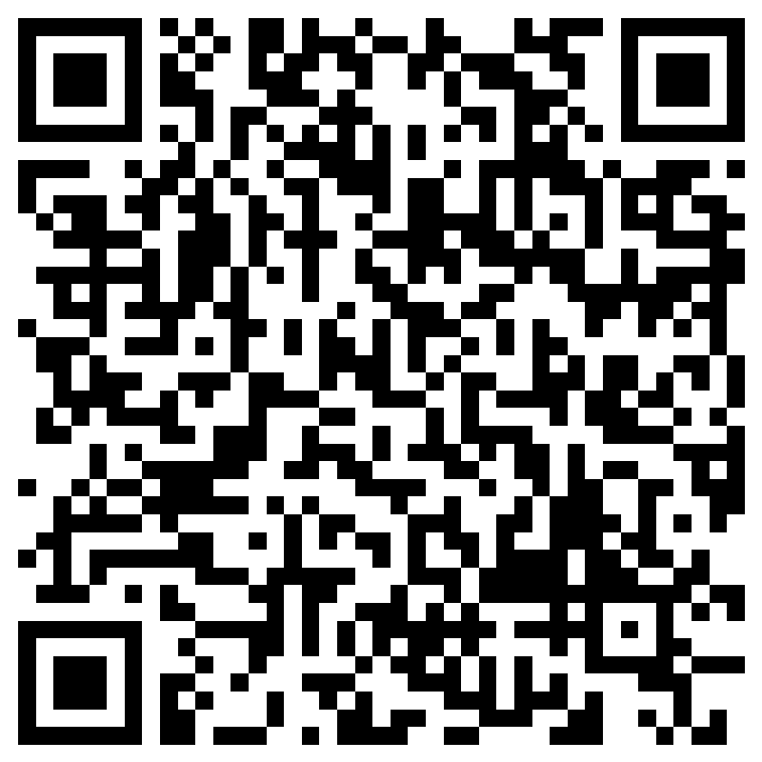
SENIOR SURVEY
Please complete the Senior Survey online
https://forms.office.com/r/DfXAfZLLPh
Or

Slide 34
Questions?
I am here to help students and parents plan for post-secondary options. Email me if you would like to set up an appointment.
Teresa Dennis 850-561-8365 or dennist@leonschools.net

